Slide 1
Exact Nearest Neighbor Algorithms

Slide 2
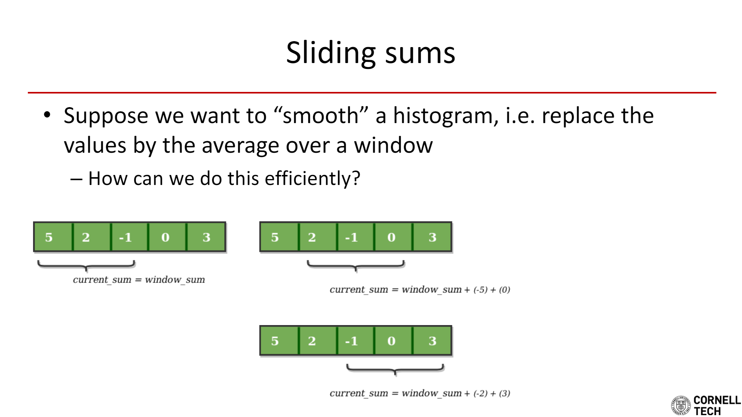

Slide 3

Sabermetrics
One of the best players ever
.310 batting average
3,465 hits
260 home runs
1,311 RBIs
14x All-star
5x World Series winner
Who is the next Derek Jeter?
Derek Jeter
Source: Wikipedia

Slide 4
Sabermetrics
Classic example of nearest neighbor application
Hits, Home runs, RBIs, etc. are dimensions in “Baseball-space”
Every individual player has a unique point in this space
Problem reduces to finding closest point in this space

Slide 5
POI Suggestions
Simpler example, only 2d space
Known set of interest points in a map - we want to suggest the closest
Note: we could make this more complicated; we could add dimensions for ratings, category, newness, etc.
How do we figure out what to suggest?
Brute force: just compute distance to all known points and pick lowest
O(n) in the number of points
Feels wasteful… why look at the distance to the Eiffel Tower when we know you’re in NYC?
Space partitioning

Slide 6
2d trees
5
x
x
(4,3)
4
x
3
x
2
x
x
1
x
1
2
3
4
5
6
7
8

Slide 7
2d trees
5
x
x
(4,3)
4
x
3
x
(1,4)
(6,2)
2
x
x
1
x
1
2
3
4
5
6
7
8

Slide 8
2d trees
5
x
x
(4,3)
4
x
3
x
(1,4)
(6,2)
2
x
x
(2,2)
(3,5)
1
x
1
2
3
4
5
6
7
8

Slide 9
2d trees
5
x
x
(4,3)
4
x
3
x
(1,4)
(6,2)
2
x
x
(2,2)
(3,5)
(7,2)
(8,5)
1
x
1
2
3
4
5
6
7
8

Slide 10
2d trees
5
x
x
(4,3)
4
x
3
x
(1,4)
(6,2)
2
x
x
(2,2)
(3,5)
(7,2)
(8,5)
1
x
1
2
3
4
5
6
7
8

Slide 11
2d trees - Nearest Neighbor
5
x
x
(4,3)
4
x
x
3
x
(1,4)
(6,2)
2
x
x
(2,2)
(3,5)
(7,2)
(8,5)
1
x
1
2
3
4
5
6
7
8

Slide 12
2d trees - Nearest Neighbor
5
x
x
(4,3)
4
x
x
3
x
(1,4)
(6,2)
2
x
x
(2,2)
(3,5)
(7,2)
(8,5)
1
x
1
2
3
4
5
6
7
8

Slide 13
2d trees - Nearest Neighbor
5
x
x
(4,3)
4
x
x
3
x
(1,4)
(6,2)
2
x
x
(2,2)
(3,5)
(7,2)
(8,5)
1
x
1
2
3
4
5
6
7
8

Slide 14
2d trees - Nearest Neighbor
5
x
x
(4,3)
√10
4
x
x
3
x
(1,4)
(6,2)
2
x
x
(2,2)
(3,5)
(7,2)
(8,5)
1
x
1
2
3
4
5
6
7
8

Slide 15
2d trees - Nearest Neighbor
5
x
x
(4,3)
√10
4
x
x
3
x
(1,4)
(6,2)
2
x
x
(2,2)
(3,5)
(7,2)
(8,5)
1
x
1
2
3
4
5
6
7
8

Slide 16
2d trees - Nearest Neighbor
5
x
x
(4,3)
√10
4
x
x
3
x
(1,4)
(6,2)
√5
2
x
x
(2,2)
(3,5)
(7,2)
(8,5)
1
x
1
2
3
4
5
6
7
8

Slide 17
2d trees - Nearest Neighbor
5
x
x
(4,3)
3
4
x
x
3
x
(1,4)
(6,2)
√5
2
x
x
(2,2)
(3,5)
(7,2)
(8,5)
1
x
1
2
3
4
5
6
7
8

Slide 18
2d trees - Nearest Neighbor
5
x
x
(4,3)
3
4
x
x
3
x
(1,4)
(6,2)
√5
2
x
x
(2,2)
(3,5)
(7,2)
(8,5)
1
x
1
2
3
4
5
6
7
8

Slide 19
2d trees - Nearest Neighbor
5
x
x
(4,3)
4
x
x
3
x
(1,4)
(6,2)
√5
2
x
x
(2,2)
(3,5)
(7,2)
(8,5)
1
x
1
2
3
4
5
6
7
8

Slide 20
2d trees - Nearest Neighbor
5
x
x
(4,3)
4
x
x
3
x
(1,4)
(6,2)
√5
2
x
x
(2,2)
(3,5)
(7,2)
(8,5)
√2
1
x
1
2
3
4
5
6
7
8

Slide 21
2d trees - Nearest Neighbor
5
x
x
(4,3)
4
x
x
3
x
2
(1,4)
(6,2)
2
x
x
(2,2)
(3,5)
(7,2)
(8,5)
√2
1
x
1
2
3
4
5
6
7
8

Slide 22
2d trees - Nearest Neighbor
5
x
x
(4,3)
4
x
x
3
x
2
(1,4)
(6,2)
2
x
x
(2,2)
(3,5)
(7,2)
(8,5)
√2
1
x
1
2
3
4
5
6
7
8

Slide 23
2d trees - Nearest Neighbor
5
x
x
(4,3)
4
x
x
3
x
(1,4)
(6,2)
2
x
x
(2,2)
(3,5)
(7,2)
(8,5)
√2
1
x
1
2
3
4
5
6
7
8

Slide 24
2d trees - Nearest Neighbor
5
x
x
x
(4,3)
4
x
3
x
(1,4)
(6,2)
2
x
x
(2,2)
(3,5)
(7,2)
(8,5)
1
x
1
2
3
4
5
6
7
8

Slide 25
2d trees - Nearest Neighbor
5
x
x
x
(4,3)
4
x
3
x
(1,4)
(6,2)
2
x
x
(2,2)
(3,5)
(7,2)
(8,5)
1
x
1
2
3
4
5
6
7
8

Slide 26
2d trees - Nearest Neighbor
5
x
x
x
(4,3)
4
x
3
x
(1,4)
(6,2)
2
x
x
(2,2)
(3,5)
(7,2)
(8,5)
1
x
1
2
3
4
5
6
7
8

Slide 27
2d trees - Nearest Neighbor
5
x
x
x
(4,3)
√5
4
x
3
x
(1,4)
(6,2)
2
x
x
(2,2)
(3,5)
(7,2)
(8,5)
1
x
1
2
3
4
5
6
7
8

Slide 28
2d trees - Nearest Neighbor
5
x
x
x
(4,3)
√5
4
x
3
x
(1,4)
(6,2)
2
x
x
(2,2)
(3,5)
(7,2)
(8,5)
1
x
1
2
3
4
5
6
7
8

Slide 29
2d trees - Nearest Neighbor
5
x
x
x
(4,3)
√5
4
x
3
x
(1,4)
(6,2)
√10
2
x
x
(2,2)
(3,5)
(7,2)
(8,5)
1
x
1
2
3
4
5
6
7
8

Slide 30
2d trees - Nearest Neighbor
5
x
x
x
(4,3)
√5
4
x
3
(1,4)
(6,2)
√10
3
x
2
x
x
(2,2)
(3,5)
(7,2)
(8,5)
1
x
1
2
3
4
5
6
7
8

Slide 31
2d trees - Nearest Neighbor
5
x
x
x
(4,3)
√5
4
x
3
(1,4)
(6,2)
√10
3
x
2
x
x
(2,2)
(3,5)
(7,2)
(8,5)
1
x
1
2
3
4
5
6
7
8

Slide 32
2d trees - Nearest Neighbor
5
x
x
x
(4,3)
√5
4
x
3
x
(1,4)
(6,2)
√10
2
x
x
(2,2)
(3,5)
(7,2)
(8,5)
1
x
1
2
3
4
5
6
7
8

Slide 33
2d trees - Nearest Neighbor
5
x
x
x
(4,3)
√5
4
x
3
x
(1,4)
(6,2)
√10
2
x
x
(2,2)
(3,5)
(7,2)
(8,5)
3
1
x
1
2
3
4
5
6
7
8

Slide 34
2d trees - Nearest Neighbor
5
x
x
x
(4,3)
√5
4
x
3
x
(1,4)
(6,2)
√10
2
x
x
(2,2)
(3,5)
(7,2)
(8,5)
3
1
x
1
2
3
4
5
6
7
8

Slide 35
2d trees - Nearest Neighbor
5
x
x
x
(4,3)
√5
4
x
3
x
√17
(1,4)
(6,2)
√10
2
x
x
(2,2)
(3,5)
(7,2)
(8,5)
3
1
x
1
2
3
4
5
6
7
8

Slide 36
2d trees - Nearest Neighbor
5
x
x
x
(4,3)
√5
4
x
3
x
√17
(1,4)
(6,2)
√10
2
x
x
(2,2)
(3,5)
(7,2)
(8,5)
3
1
x
1
2
3
4
5
6
7
8

Slide 37
2d trees - Nearest Neighbor
5
x
x
x
(4,3)
√5
4
x
3
x
√17
(1,4)
(6,2)
√10
2
x
x
2
(2,2)
(3,5)
(7,2)
(8,5)
3
1
x
1
2
3
4
5
6
7
8

Slide 38
2d trees - Nearest Neighbor
5
x
x
x
(4,3)
√5
4
x
3
x
√17
(1,4)
(6,2)
√10
2
x
x
2
(2,2)
(3,5)
(7,2)
(8,5)
3
1
x
1
2
3
4
5
6
7
8

Slide 39
2d trees - Nearest Neighbor
5
x
x
x
(4,3)
√5
4
x
3
x
√17
(1,4)
(6,2)
√10
2
x
x
2
√18
(2,2)
(3,5)
(7,2)
(8,5)
3
1
x
1
2
3
4
5
6
7
8

Slide 40
2d trees - Nearest Neighbor
5
x
x
x
(4,3)
√5
4
x
3
x
√17
(1,4)
(6,2)
√10
2
x
x
2
√18
(2,2)
(3,5)
(7,2)
(8,5)
3
1
x
1
2
3
4
5
6
7
8

Slide 41
2d trees
Construction complexity: O(n log n)
Complication: how do you decide how to partition?
Requires you be smart about picking pivots
Adding/Removing element: O(log n)
This is because we know it’s balanced from the median selection
...except adding/removing might make it unbalanced -- there are variants that handle this
Nearest Neighbor
Average case: O(log n)
Worst case: O(n)
Not great… but not worse than brute force
Can also be used effectively for range finding

Slide 42
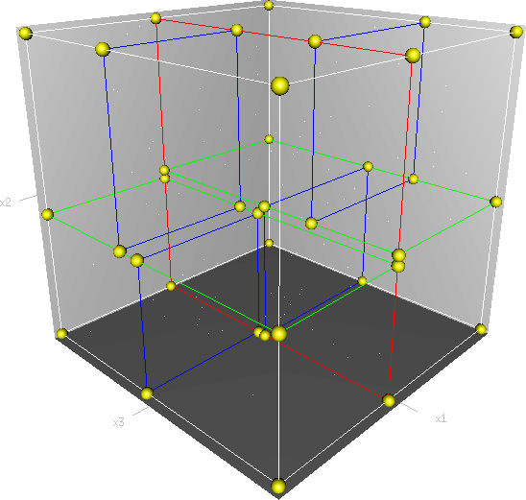
k-d trees
2d trees can be extended to k dimensions
Image Source: Wikipedia

Slide 43
k-d trees
Same algorithm for nearest neighbor!
Remember sabermetrics!
...except there’s a catch
Curse of Dimensionality
The higher the dimensions, the “sparser” the data gets in the space
Harder to rule out portions of the tree, so many searches end up being fancy brute forces
In general, k-d trees are useful when N >> 2^{k}

Slide 44
Sabermetrics (reprise)
Finding single neighbor could be noise-prone
Are we sure this year’s “Derek Jeter” will be next year’s too?
What if there are lots of close points… are we sure that the relative distance matters?
Could ask for set of most likely players
Alternate question: will a player make it to the Hall of Fame?
Still k-dimensional space, but we’re not comparing with individual point
Am I in the “neighborhood” of Hall of Famers?
Classic example of “classification problem”

Slide 45
k-Nearest Neighbors (kNN)
New plan: find the k closest points
Each can “vote” for a classification
…or you can do some other kind of averaging
Can we modify our k-d tree NN algorithm to do this?
Track k closest points in max-heap (priority queue)
Keep heap at size k
Only need to consider k’th closest point for tree pruning

Slide 46
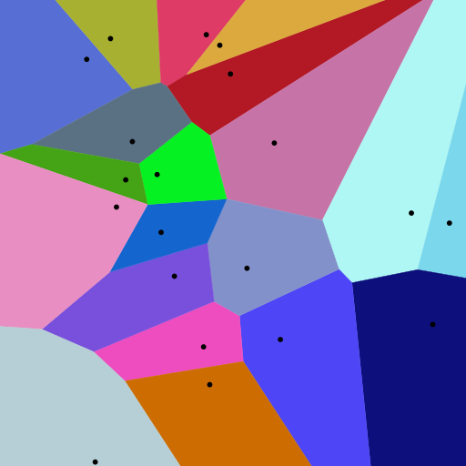
Voronoi Diagrams
Useful visualization of nearest neighbors
Good when you have a known set of comparison points
Wide ranging applications
Epidemiology
Cholera victims all near one water pump
Aviation
Nearest airport for flight diversion
Networking
Capacity derivation
Robotics
Points are obstacles, edges are safest paths
Image Source: Wikipedia

Slide 47
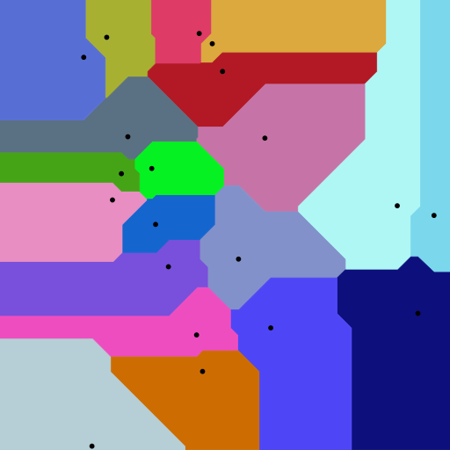
Voronoi Diagrams
Also helpful for visualizing effects of different distance metrics
Euclidean distance
Manhattan distance
Image Source: Wikipedia

Slide 48
Voronoi Diagrams
Polygon construction algorithm is a little tricky, but conceptually you can think of expanding balls around the points
Image Source: Wikipedia

Slide 49
k-means Clustering
Goal: Group n data points into k groups based on nearest neighbor
Algorithm:
Pick k data points at random to be starting “centers,” call each center c_{i}
For each node n, calculate which of the k centers is the nearest neighbor and add it to set S_{i}
Compute the mean of all points in S_{i} to generate a new c_{i}
Go back to (2) and repeat with the new centers, until the centers converge

Slide 50
k-means clustering
Notice: the algorithm basically creates Voronoi diagrams for the centers!
Image Source: Wikipedia

Slide 51
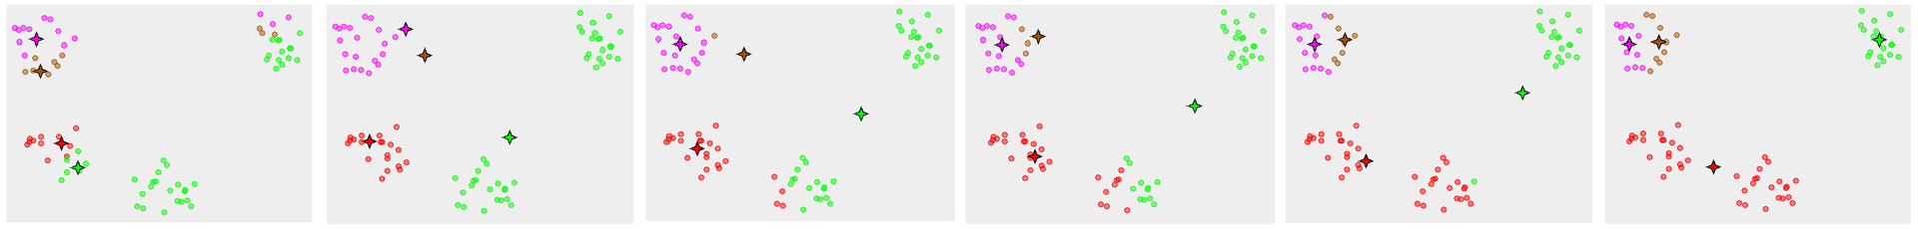
k-means clustering
Does this always converge?
Depends on distance function. Generally yes for Euclidean
Converges quickly in practice, but worst case can take an exponential number of iterations
Does it give the optimal clustering?
NO! Well, at least not always.
Image Source: Wikipedia

Slide 52
Other space partitioning data structures
Leaf point k-d trees
Only stores points in leaves, but leaves can store more than one point
Split space at the middle of longest axis
Effectively “buckets” points - can be used for approximate nearest neighbor
Quadtrees
Split space into quadrants (i.e. every tree node has four children)
Quadrant can only contain at most q nodes
If there are more than q, split that quadrant again into quadrants
Applications
Collision detection (video games)
Image representation/processing (transforming/comparing/etc. nearby pixels)
Sparse data storage (spreadsheets)
Octrees are extension to 3d

